Slide 1
s
e
c
o
n
d
C
O
R
N
A
N
I
T
H
I
S
1.1-11
A free CD of this message will be available following the service
It will also be available for podcast later this week at calvaryokc.com

Slide 2
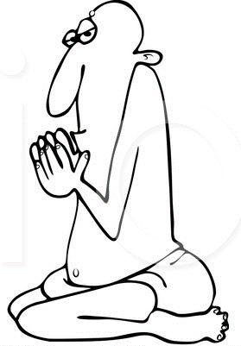
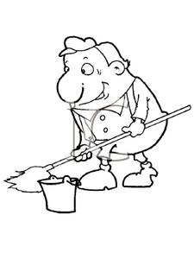
Oh, great one,
I am less than nothing! I don't exist and I never did. You are all there is!
Oh mighty one, I too am
nothing, you are everything.
Humph! How dare he! Look who thinks he’s nothing!
Oh, Master,
I am nothing, I don't exist, all there is, is You.
O
A
N
S
1.1-11
I
I
s
e
c
o
n
d
C
R
N
T
H

Slide 3
O
A
N
S
1.1-11
I
I
s
e
c
o
n
d
C
R
N
T
H

Slide 4
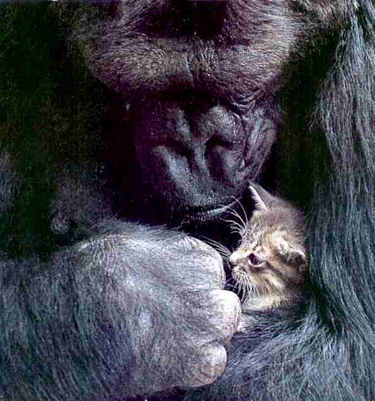
Meekness - power under control
O
A
N
S
1.1-11
I
I
s
e
c
o
n
d
C
R
N
T
H

Slide 5
O
A
N
S
1.1-11
I
I
s
e
c
o
n
d
C
R
N
T
H

Slide 6
Merrihew Standard Version - Even though we live in these physical bodies, we don’t resort to our physical resources to win the war.
O
A
N
S
1.1-11
I
I
s
e
c
o
n
d
C
R
N
T
H

Slide 7
O
A
N
S
1.1-11
I
I
s
e
c
o
n
d
C
R
N
T
H

Slide 8
Warfare - strateia – strategy
Strongholds - NASB, fortresses (castles)
O
A
N
S
1.1-11
I
I
s
e
c
o
n
d
C
R
N
T
H

Slide 9
O
A
N
S
1.1-11
I
I
s
e
c
o
n
d
C
R
N
T
H

Slide 10
Casting down - to remove by way of force
Present participle - casting down and to keep on casting down
Arguments – logimos (Logic)
NASB - speculations; KJV - imaginations
High thing - hupsōma – from word for “exalt”
O
A
N
S
1.1-11
I
I
s
e
c
o
n
d
C
R
N
T
H

Slide 11
Phil. 4:8 - Finally, brethren, whatever things are true, whatever things are noble, whatever things are just, whatever things are pure, whatever things are lovely, whatever things are of good report, if there is any virtue and if there is anything praiseworthy—meditate on these things.
O
A
N
S
1.1-11
I
I
s
e
c
o
n
d
C
R
N
T
H

Slide 12
O
A
N
S
1.1-11
I
I
s
e
c
o
n
d
C
R
N
T
H

Slide 13
Punish - ekdikeō – literally, avenges
Disobedience -
parakoē
Aside from hearing
obedience -
hupakoē
Under hearing
akouō – to hear (acoustic)
para – aside from
hupo – under
O
A
N
S
1.1-11
I
I
s
e
c
o
n
d
C
R
N
T
H

Slide 14
A. W. Tozer (1897-1963) - “‘Christ in you, the hope of glory.’ I’m not afraid of the devil. The devil can handle me – he’s got judo I never heard of. But he can’t handle the One to whom I’m joined; he can’t handle the One to whom I’m united; he can’t handle the One whose nature dwells in my nature.”
O
A
N
S
1.1-11
I
I
s
e
c
o
n
d
C
R
N
T
H

Slide 15
O
A
N
S
1.1-11
I
I
s
e
c
o
n
d
C
R
N
T
H

Slide 16
Destruction - kathairesis – same as v. 4 (pulling down)
O
A
N
S
1.1-11
I
I
s
e
c
o
n
d
C
R
N
T
H

Slide 17
O
A
N
S
1.1-11
I
I
s
e
c
o
n
d
C
R
N
T
H

Slide 18
They say - literally he says (third person singular)
O
A
N
S
1.1-11
I
I
s
e
c
o
n
d
C
R
N
T
H

Slide 19
O
A
N
S
1.1-11
I
I
s
e
c
o
n
d
C
R
N
T
H

Slide 20
Warren Wiersbe (b. 1929) - “The difference between Paul and the Judaizers was this: Paul used his authority to build up the church, while the Judaizers used the church to build up their authority.”
O
A
N
S
1.1-11
I
I
s
e
c
o
n
d
C
R
N
T
H

Slide 21
O
A
N
S
1.1-11
I
I
s
e
c
o
n
d
C
R
N
T
H

